Slide 1
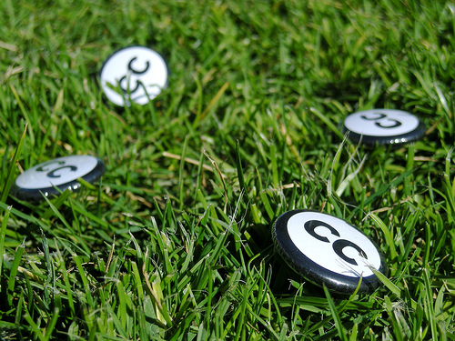



Creative Commons: an introduction
Jessica Coates
Creative Commons Clinic
April 2008
Carpeted commons by Glutnix, http://www.flickr.com/photos/glutnix/2079709803/in/pool-ccswagcontest07 available under a Creative Commons Attribution 2.0 licence, http://creativecommons.org/licenses/by/2.0/deed.en
AUSTRALIA
part of the Creative Commons international initiative
CRICOS No. 00213J

Slide 2
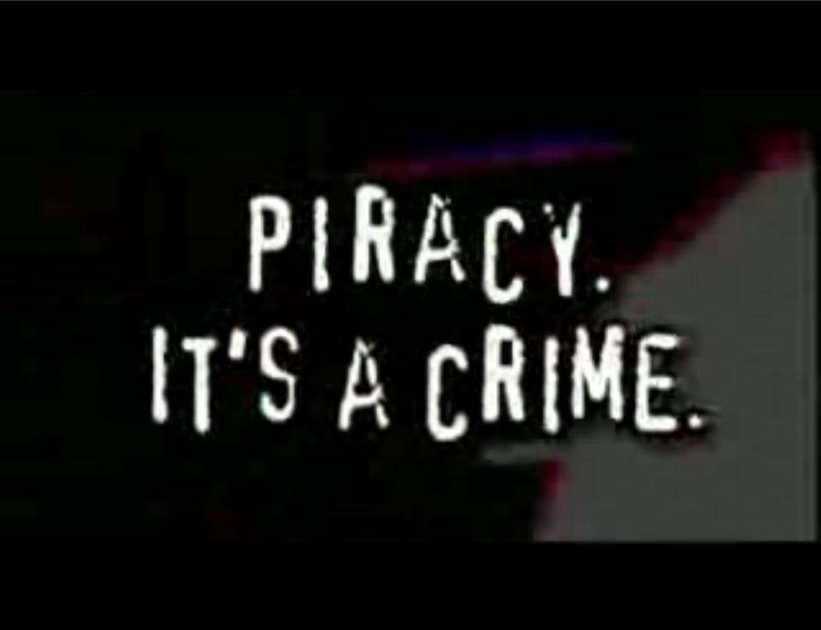

AUSTRALIA
part of the Creative Commons international initiative
CRICOS No. 00213J
Notes:
Thanks to hollywood, we all know that copyright and the internet don’t sit well together.
A lot of these problems come from the fact that the internet has made public the kinds of acts that previously only occurred in private
Standard copyright law says that you can’t reproduce or communicate creative material (eg movies, books, music etc) without the copyright owner’s permission, except in very limited circumstances
The problem with this in the digital era is that every use of material makes a reproduction. This includes just viewing
This means that, under the default copyright laws, printing out a webpage, emailing a picture to your friend, making a digital collage or remix work etc will all generally infringe copyright
reproduction doesn’t just mean verbatim – includes ‘transformative’ uses
need permission for any new work that includes part of old work – even small part, or artistic (unless exception

Slide 3
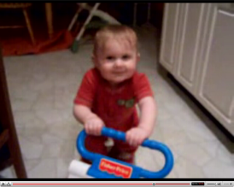
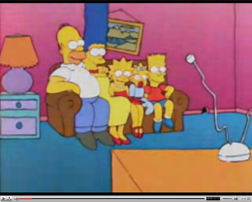

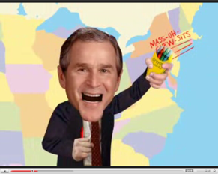
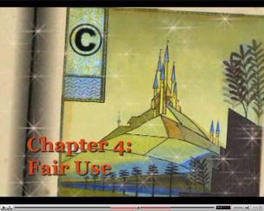

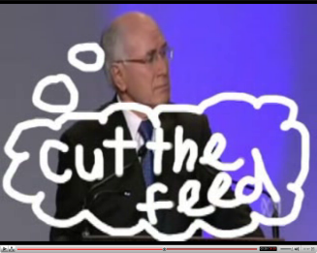
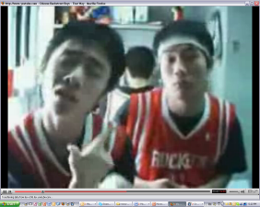
AUSTRALIA
part of the Creative Commons international initiative
CRICOS No. 00213J
Notes:
Standard copyright law says that you can’t reproduce or communicate creative material (eg movies, books, music etc) without the copyright owner’s permission, except in very limited circumstances
The problem with this in the digital era is that every use of material makes a reproduction. This includes just viewing
This means that, under the default copyright laws, printing out a webpage, emailing a picture to your friend, making a digital collage or remix work etc will all generally infringe copyright

Slide 4
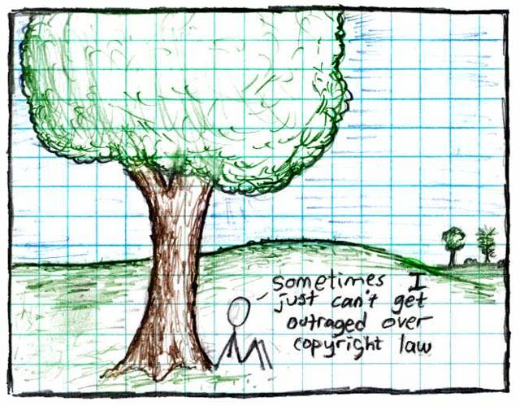
"Copyright", Randall Munroe, http://xkcd.org/14/, Creative Commons Attribution-NonCommercial 2.5 license
AUSTRALIA
part of the Creative Commons international initiative
CRICOS No. 00213J
Notes:
Some just say ignore copyright law – rip, mix, burn
This is ok if you’re an private user, or an obscure artist – can choose to take risk
But doesn’t work for schools, libraries, museums, charities, academics, short film makers entering into competitions, DJs releasing a commercial CD etc
Plus, the music labels and hollywood are suing people now – and in the UK they’re threatening to cut off people’s internet connections.

Slide 5
Enter Creative Commons
Aims to make copyright material more useable by providing free licences that creators can use to give certain permissions in advance
AUSTRALIA
part of the Creative Commons international initiative
CRICOS No. 00213J
Notes:
Non-profit
Founded in 2001
These academics became concerned that the default copyright laws that applied in most countries were restricting creativity in the digital environment by preventing people from being able to access, remix and distribute copyright material online
Taking inspiration from the open source movement, they decided to develop a set of licences that creators could use to make their material more freely available without giving up their copyright
They wanted to replace the standard “all rights reserved” model with a new, more flexible, “some rights reserved”

Slide 6

CC is designed to…
provide standardised licences
that facilitate sharing
are flexible
are easy to use and understand (for people and machines) and
that apply in the same way anywhere in the world.
AUSTRALIA
part of the Creative Commons international initiative
CRICOS No. 00213J
Notes:
In writing the licences, the main goal was to ensure that the licences are:
Voluntary – contrary to some claims, CC isn’t anti-copyright. It just aims to provide options for those copyright owners who do want to make their material more freely available
Flexible – unlike other parts of the open access movement, CC licences are specifically designed to provide a range of options for licensors, so that they can choose exactly how they want their material to be used
Easy to understand – the academics designing the licences felt that one of the biggest problems with default copyright law is that its so hard for both copyright owners and users to understand. So the licences are specifically designed to be as simple as possible.
And, of course, freely available for everyone to use

Slide 7
CC Myths
CC is not:
Anti-copyright – just another rights management tool for creators
Anti-commercial – can charge for first use, commercial uses, “premium” service, or embed advertising
Right for every situation – entirely voluntary, and won’t be best solution for all creators
AUSTRALIA
part of the Creative Commons international initiative
CRICOS No. 00213J
Notes:
Non-profit
Founded in 2001
These academics became concerned that the default copyright laws that applied in most countries were restricting creativity in the digital environment by preventing people from being able to access, remix and distribute copyright material online
For instances – most people know that it’s currently illegal under Australian law to record a television show to watch later – but did you also know that, in the absence of any licence, it’s also arguably illegal to print off a webpage for personal use, or to use a song in the background of a home video, or a student film
Even those people who want to make their material more freely available can’t do so without hiring lawyers
Taking inspiration from the open source movement, they decided to develop a set of licences that creators could use to make their material more freely available without giving up their copyright
They wanted to replace the standard “all rights reserved” model with a new, more flexible, “some rights reserved”

Slide 8




Licence elements
        Attribution
        Noncommercial
        No Derivative Works
        ShareAlike
AUSTRALIA
part of the Creative Commons international initiative
CRICOS No. 00213J
Notes:
The first CC licences were released in 2002
The central to each of the CC licences are the four licence elements – Attribution, noncommercial, no derivative and sharealike
These represent restrictions that copyright owners may want to put on how people can use their material.
As you can see, each of the elements has a symbol that can be used to ‘represent’ each of these elements
this makes the licences easier understand – in theory, once a person is familiar with the CC licences, they should be able to recognise what uses are allowed simply by looking at the symbols

Slide 9
Licences
creators mix and match elements to make licence
  eg Attribution-Noncommercial-ShareAlike
lets others remix, tweak, and build upon the work, as long as:
  they credit the author;
  it is for non-commercial purposes; and
  they license their new creations under the same terms
AUSTRALIA
part of the Creative Commons international initiative
CRICOS No. 00213J
Notes:
Users can mix and match these elements to set the conditions of use for their material
So, for example, an author may be happy to allow private uses of their work, but may want to limit how it can be used commercially.
They may also want people to remix their work, but only so long as that person attributes them and makes the new work available for others to remix
So they can choose the Attribution-noncommercial-sharealike licence

Slide 10
Licences
Attribution
Attribution-Noncommercial
Attribution-NoDerivatives
Attribution-ShareAlike
Attribution-Noncommercial-ShareAlike
Attribution-Noncommercial-NoDerivatives
AUSTRALIA
part of the Creative Commons international initiative
CRICOS No. 00213J
Notes:
Users can mix and match these elements to set the conditions of use for their material
So, for example, an author may be happy to allow private uses of their work, but may want to limit how it can be used commercially.
They may also want people to remix their work, but only so long as that person attributes them and makes the new work available for others to remix
So they can choose the Attribution-noncommercial-sharealike licence

Slide 11
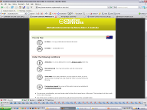
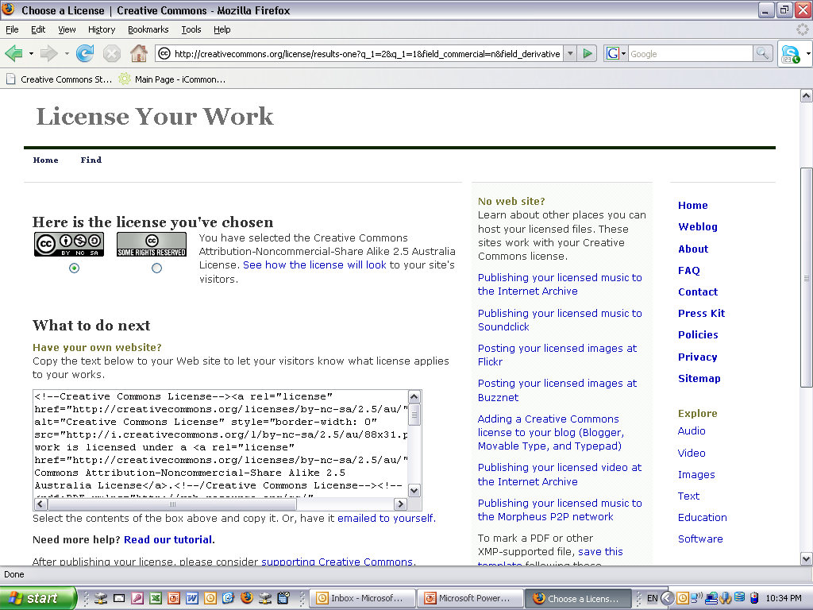
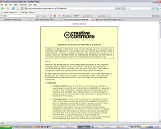
Each licence has…
button
deed
metadata
legal code
AUSTRALIA
part of the Creative Commons international initiative
CRICOS No. 00213J
Notes:
CC also has a number of tailored licences, for example:
the Sampling Licences – allow portions of a work, but not the whole, to be remixed into new works, even commercially;
the Public Domain Dedication – lets creators revoke their copyright rights entirely, and donate their work to the public domain;

Slide 12
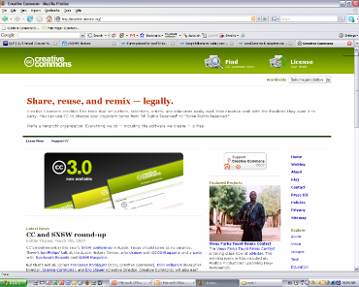
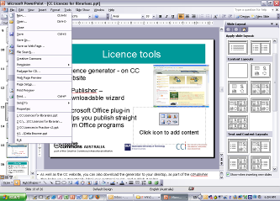
Choosing a licence
Licence generator – on CC website – uses simple questions to determine appropriate licence
Available in lots of forms eg:
  ccPublisher – downloadable desktop wizard
  Microsoft plug-in –allows you to CC license straight from Office programs
  Individual site generators eg Flickr
AUSTRALIA
part of the Creative Commons international initiative
CRICOS No. 00213J
Notes:
As well as the CC website, you can also download the generator to your desktop, as part of the ccPublisher
This helps you automatically label your material as CC, and publish it online
In an interesting development, Microsoft has also recently released an plugin that allows you to label any work created in an Office as CC.
A number of sites also let you licence your material as cc – including flickr, and blip.tv

Slide 13
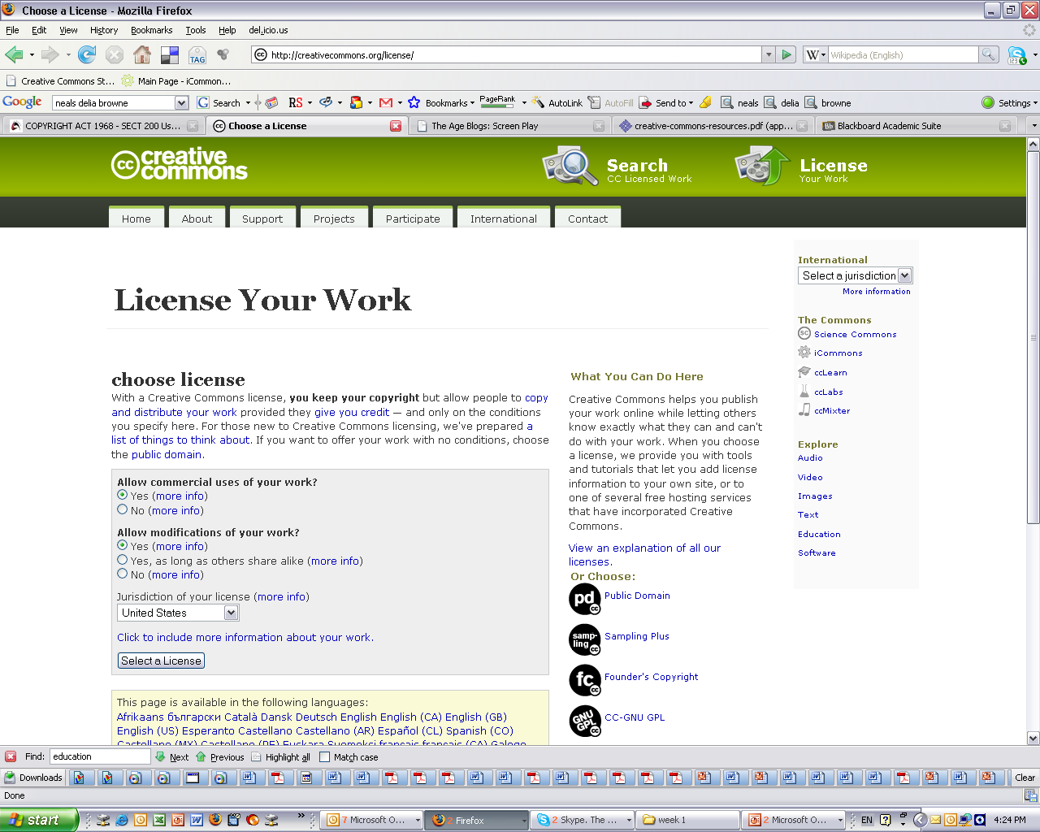
Licences
AUSTRALIA
part of the Creative Commons international initiative

Slide 14
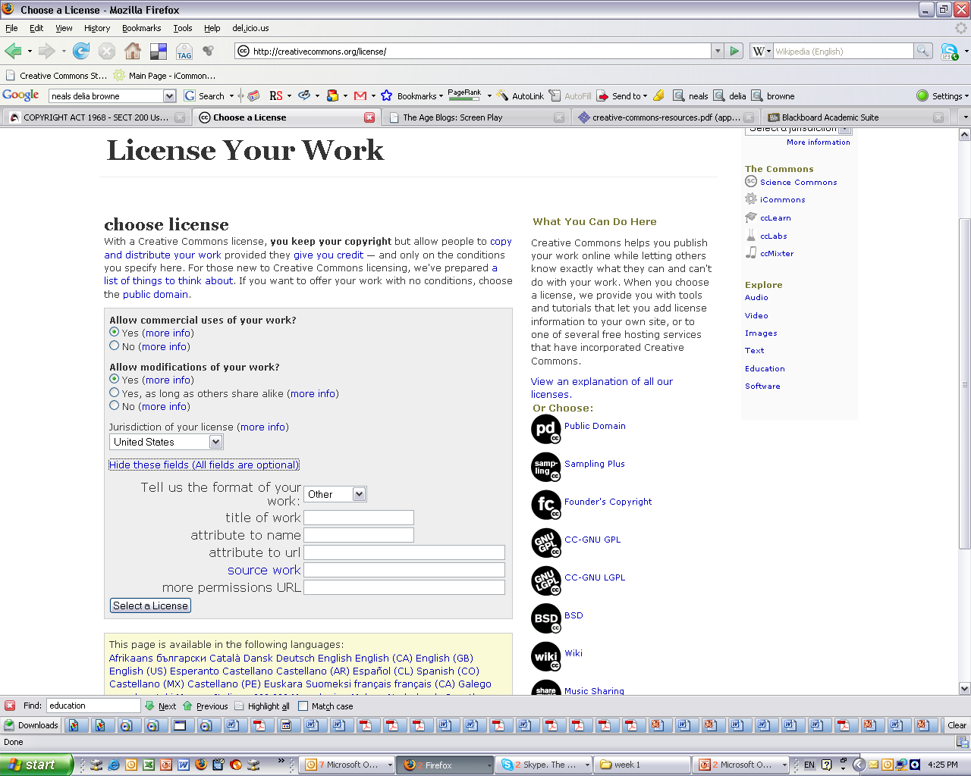
Licences
AUSTRALIA
part of the Creative Commons international initiative

Slide 15
Licences
AUSTRALIA
part of the Creative Commons international initiative
Notes:
Selecting a licence takes you through to a page that provides you with some XHTML text that you can copy onto you website
This basically ‘embeds’ the cc licence into your work, and displays the ‘licence button’ on your site
By clicking on the button, you’re taken through. . .

Slide 16











Finding CC material
AUSTRALIA
part of the Creative Commons international initiative
CRICOS No. 00213J

Slide 17
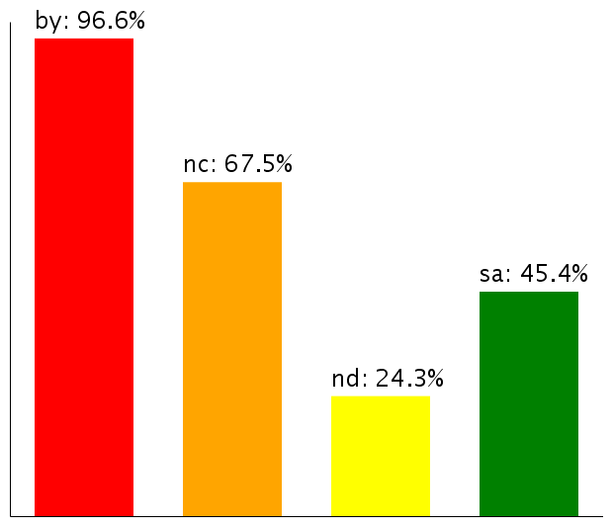
Licence Use
After one year about 1 million objects
By mid-2006 about 140 million
Now – over 60 million on Flickr alone
Most have Noncommercial limitation
Moving towards more liberal licences
Use of licence elements – June 2006
AUSTRALIA
part of the Creative Commons international initiative
CRICOS No. 00213J
Notes:
So – looking at how the CC licences are being used
According to the latest statistics from the CC website, there are currently about 140million webpages that use a CC licence
As you can see, almost all of them contain the BY element – that’s because it was made compulsory for all the licences except the public domain licences after the first year, because pretty much everybody was using it anyway
The majority also, unsurprisingly, choose the non-commercial element
Interestingly, next most popular is ShareAlike, not noderivatives – this shows that there is still a strong focus on fostering creativity among CC community, and that, rather than trying to lock their material up, people are happy for it to be remixed, as long as the new work is also sharedEven more interesting is how these statistics are changing over time
Even more interestingly – if you look at how the licences is being used over time, people are gradually moving towards more liberal licences with less restrictions on them
This movement seems to indicate that as people become more familiar with the licences, they are more comfortable allowing greater use
This is supported by anecdotal evidence from CC users who, after initially publishing their material under restrictive licences that don’t allow derivatives, often ‘re-release’ their material to allow new works

Slide 18
Why share?
Facilitates collaboration – eg joint works, remixers
Increases reach and reputation – eg unsigned bands, previews, ‘word of mouth’
Access new business models – eg ‘niche’ markets, advertising
Gives new value to ‘back catalogue’ – eg BBC Creative Archive
Community engagement – eg peer review
Reduces costs for users - eg schools, libraries, charities
Legal clarity and reduced admin
Increases sum of human knowledge, encourages innovation
AUSTRALIA
part of the Creative Commons international initiative
CRICOS No. 00213J
Notes:
In writing the licences, the main goal was to ensure that the licences are:
Voluntary – contrary to some claims, CC isn’t anti-copyright. It just aims to provide options for those copyright owners who do want to make their material more freely available
Flexible – unlike other parts of the open access movement, CC licences are specifically designed to provide a range of options for licensors, so that they can choose exactly how they want their material to be used
Easy to understand – the academics designing the licences felt that one of the biggest problems with default copyright law is that its so hard for both copyright owners and users to understand. So the licences are specifically designed to be as simple as possible.
And, of course, freely available for everyone to use

Slide 19
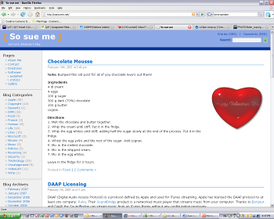
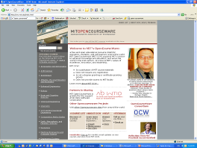


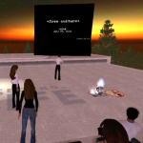

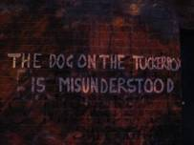

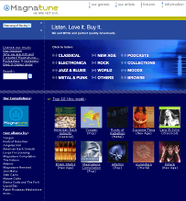
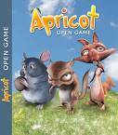
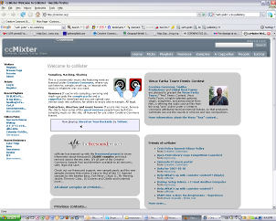


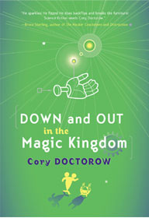
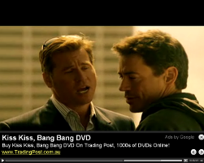


Slide 20
CC Plus
+
AUSTRALIA
part of the Creative Commons international initiative
CRICOS No. 00213J
Notes:
Another interesting “second generation” CC user is Revver
Revver is a free video sharing site, similar to Youtube
But, unlike Youtube, Revver aims to take advantage of the popularity of sharing videos online to provide a revenue-raising model for video makers
And as part of this business model, it requires that all people upload their material under a CC BY-MC-ND licence
Revver’s still in its early days, but it does already have a success story in the “extreme diet coke and mentos experiment” video
hopefully at least some of you have already seen this online
But just in case you haven’t here it is
By June this year this video has been downloaded more than 6 million times, and earned its makers over US$30,000 in revenue
It’s hosted a number of ads - first for the movie “Kiss Kiss Bang Bang” – and then for mentos.
Strangely, coke wasn’t interested
This has encouraged other popular online videos, such as “ask a ninja”, to put themselves on Revver

Slide 21

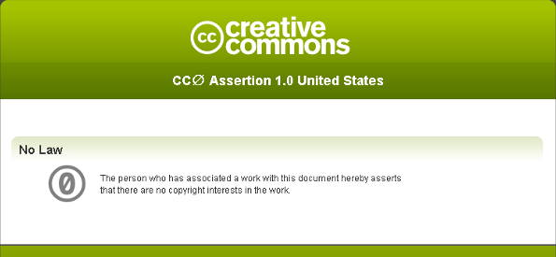
CC Zero
AUSTRALIA
part of the Creative Commons international initiative
CRICOS No. 00213J
Notes:
Another interesting “second generation” CC user is Revver
Revver is a free video sharing site, similar to Youtube
But, unlike Youtube, Revver aims to take advantage of the popularity of sharing videos online to provide a revenue-raising model for video makers
And as part of this business model, it requires that all people upload their material under a CC BY-MC-ND licence
Revver’s still in its early days, but it does already have a success story in the “extreme diet coke and mentos experiment” video
hopefully at least some of you have already seen this online
But just in case you haven’t here it is
By June this year this video has been downloaded more than 6 million times, and earned its makers over US$30,000 in revenue
It’s hosted a number of ads - first for the movie “Kiss Kiss Bang Bang” – and then for mentos.
Strangely, coke wasn’t interested
This has encouraged other popular online videos, such as “ask a ninja”, to put themselves on Revver

Slide 22
Thanks
http://www.creativecommons.org
http://www.creativecommons.org.au
info@creativecommons.org.au
Carpeted commons by Glutnix, http://www.flickr.com/photos/glutnix/2079709803/in/pool-ccswagcontest07 available under a Creative Commons Attribution 2.0 licence, http://creativecommons.org/licenses/by/2.0/deed.en
The text in this slide show is licensed under a Creative Commons Australia Attribution licence. For more information see http://creativecommons.org/licenses/by/2.5/au/. Images are licensed as noted.
AUSTRALIA
part of the Creative Commons international initiative
CRICOS No. 00213J

